Slide 1


Nashville City Cemetery
(oldest public cemetery in Nashville)
Notes:
Good Afternoon everyone. Today we are going to analyze the data provided by Nashville cemeteries and get an InSite in historical trends in medicine.

Slide 2

Nashville Cemetery interments
The cemetery was established in 1822 and is home to more than 22,000 remains, including many famous and historic Nashvillians.
Among those interred in the cemetery are two of Nashville's founders, four Confederate generals, one Tennessee Governor, and twenty-two mayors of Nashville. Also buried there are numerous soldiers, schoolteachers, former slaves, early civic leaders, and other.

Slide 3
Change in Causes of death over last century
In 1900, pneumonia and influenza, tuberculosis, and diarrhea were the three leading causes of death in the United States, and children under 5 accounted for 40 percent of all deaths from these infections.
1864 had the highest number of deaths because of Civil War. Significant number of soldiers died from camp diseases including pneumonia, typhus, and dysentery
Notes:
We analyzed the data to find top 10 causes of death and found out that consumption also knows as Tuberculosis was major contributor followed by pneumonia ,cholera , diarrhea and influenza,. infant mortality rate was also very high. 1864 had the highest number of deaths because of Civil War. Significant amount of soldiers died from camp diseases including pneumonia, typhoid, and dysentery.

Slide 4
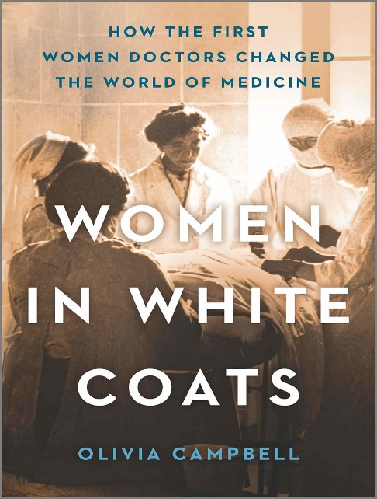
How the First Women Doctors Changed the World of Medicine
The First Woman Doctor: Elizabeth Blackwell, M.D.
Historically in the United States, young women ran a high risk of dying during or after childbirth, 600 women per 100,000 birth
For most of European and U.S. history, midwives had attended births. Some were incompetent, some were skilled
Doctors had little to do with childbirth—they were all men, and it was considered obscene for a man to be present at a birth.
Notes:
Lets see how Evolution of medicine has impacted the female mortality rate over years .In 20th century young women ran a high risk of dying during or after childbirth. Childbirths
were mainly done by midwives without proper medical equipment's. Doctors mostly male had little to do with childbirth .In the early 1800s, women were dying in large numbers from treatable diseases because they avoided receiving medical care. Examinations performed by male doctors were often demeaning and even painful. In addition, women faced stigma from illness—a diagnosis could greatly limit their ability to find husbands, jobs or be received in society. Dr. Elizabeth Blackwell was the first woman to receive an M.D. degree from an American medical school. From 1955 to 1985, maternal mortality decreased by 99 percent in the United States – “one of the greatest public health achievements of the 20th century,

Slide 5
Evolution of medicine
Higher Life Expectancy
Role of Science/Medicine- better management of infectious diseases, and more widespread access to clean water
Decline in Child and Female Mortality Rate
Notes:
Now lets see how evolution of medicine has made a significant change in transition of mortality rates. Globally the life expectancy increased from less than 30 years to over 72 years; after two centuries of progress we can expect to live more than twice as long as our ancestors.A number of factors have contributed to this including declining infant deaths, better management of infectious diseases, and more widespread access to clean water.diseases like polio,tetanus, whooping cough, measles, mumps were all virtually wiped out during the second half of the 20th century, after childhood immunization was introduced child mortality rates decreased on the decades and the life expectancy increased.Human was living a longer life . This is only the statistical analysis of the data provided by NCCA,which can be presented in the form of flyer to get interest from School ,colleges especially students studying medicine. We can incorporate importance of healthcare and how Healthcare Has Evolved Over the centuary

